Slide 1
Lab 06 – Full Adder Pt. 2
Mary and Julia

Slide 2
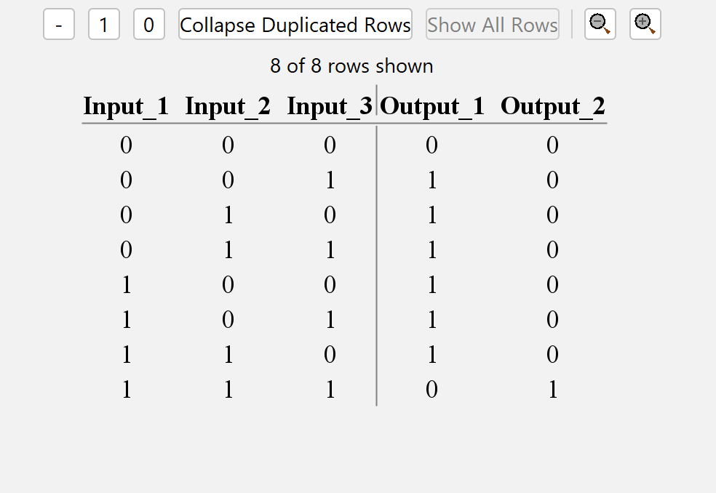
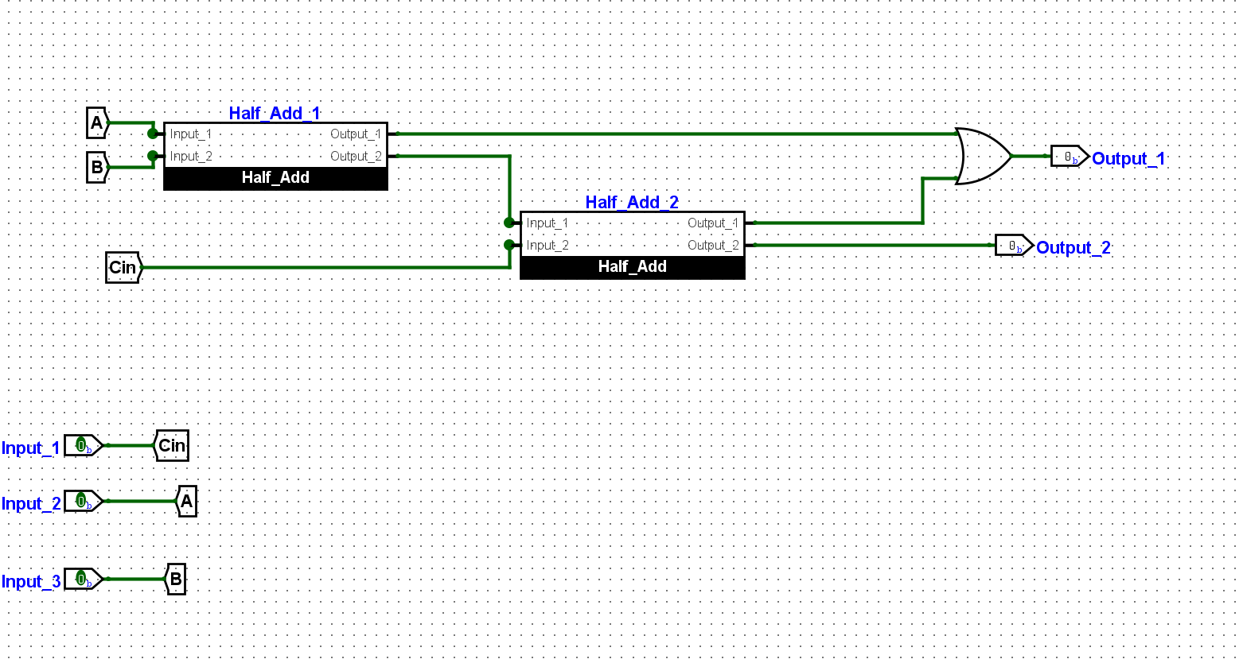
Truth Table for Full Adder
Logisim Diagram of Full Adder

